Slide 1
Automatic Program Repair : Syntax vs Semantics.
S3: Syntax- and Semantic-Guided Repair Synthesis via Programming by Examples
Presented By-
Saikat Chakraborty

Slide 2
Automatic Program Repair (APR) : What is that?
A branch of SE research that addresses generating patch for a buggy program automatically.
A bug often exhibits in the form of a fault which is exposed by test cases.
Assumptions in automatic program repair
A set of passing and at least one failing test cases are present.
A fault localization tool is available to locate which part of the program is responsible for the fault. Often that location is a candidate of patch.

Slide 3
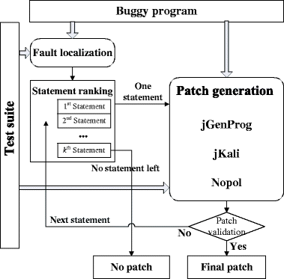
APR : Different Directions for solving the problem.
2 different solution direction.
Generate and Validate based approach.

Slide 4
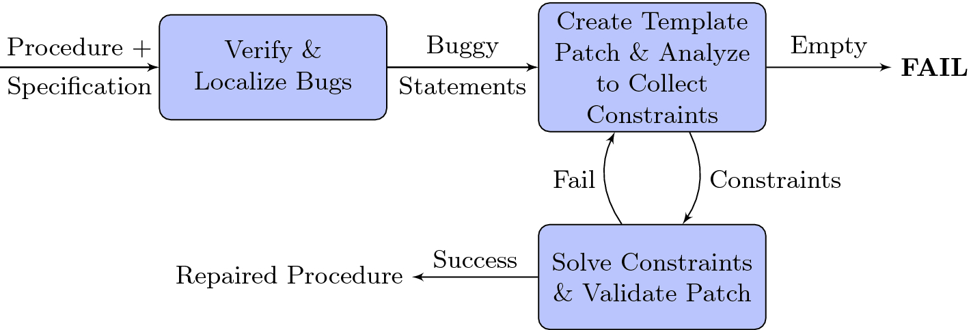
APR : Different Directions for solving the problem.
2 different solution direction.
2. Synthesis Based Approach.

Slide 5
Generate and Validate : In depth.
Main Idea : Generate independently of the test case(s). Validate after fully generated.
Often Syntax guided.
Random mutation (Genprog), Guided mutation (Elixir), History driven Text modeling (SequenceR), History driven Code syntax modeling (Codit)
Pros
Independent of test cases (less likely to OVERFIT).
Often scale well.
Good for fixing API driven bugs.
Cons
Often explore a large search space and fail to generate correct patch.

Slide 6
Synthesis Based repair : In depth.
Main Idea : Generate a constraints that satisfies the all the test cases including the failing one, solves the constraint and synthesize patch from the solution.
e.g SPR, Angelix etc.
Pros
Good for fixing arithmetic/logical bugs.
Cons
Often do not scale well.
Often has limited scope i.e. Condition Synthesis, Expression Synthesis etc.
Often OVERFIT to test cases unless carefully designed.

Slide 7
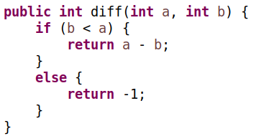
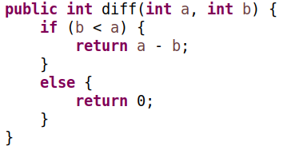
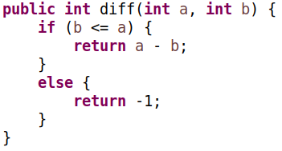
Overfitting - What is that?

Slide 8
S3 : Syntax and Semantics Guided Repair Synthesis.
Step 1: Localize the fault.
Step 2: Generate path condition and constraint from all the test cases.
Insert a symbolic variable replacing the faulty expression.
Step 3: Generate replacement expression for symbolic variable using a condition synthesis DSL.
Step 4: Rank the generated expressions that satisfies the constraint using syntactic and semantic heuristics.

Slide 9
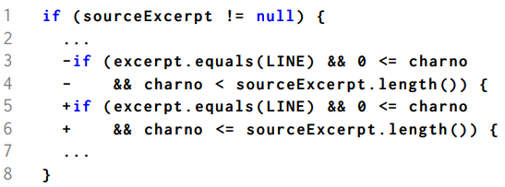
S3 : Step 1
Step 1: Localize the fault.
Ochiai metric for ranking expressions in program based on the suspiciousness.

Slide 10
S3 : Step 2
Step 2: Generate path condition and constraint from all the test cases.

Slide 11
S3 : Step 3
Step 3: Generate replacement expression for symbolic variable using a condition synthesis DSL.

Slide 12
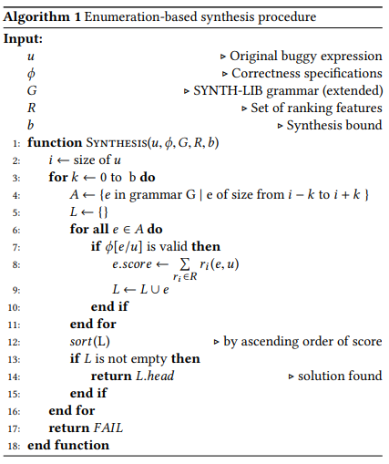
S3 : Step 4
Step 4: Rank the generated expressions that satisfies the constraint using syntactic and semantic heuristics.

Slide 13
S3 : Step 4 (contd.)
Step 4: Ranking Features
Syntactic Features
AST Difference
Cosine similarity.
Locality of variables and constants.
Semantic Features
Model counting.
Output Coverage.
Anti Pattern.

Slide 14
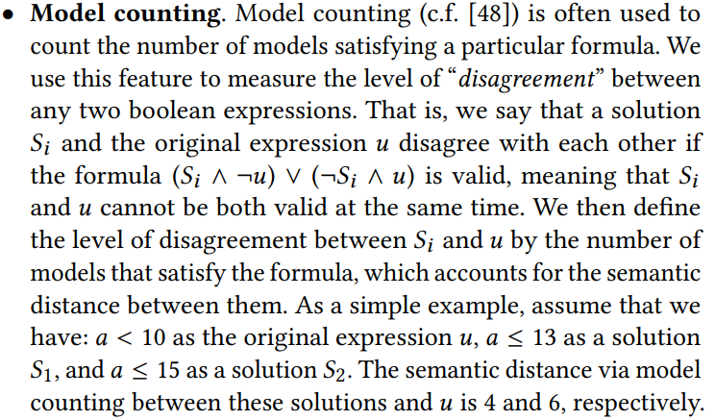
S3 : Step 4 (contd.)

Slide 15
S3 : Step 4 (contd.)

Slide 16
S3 : Step 4 (contd.)

Slide 17
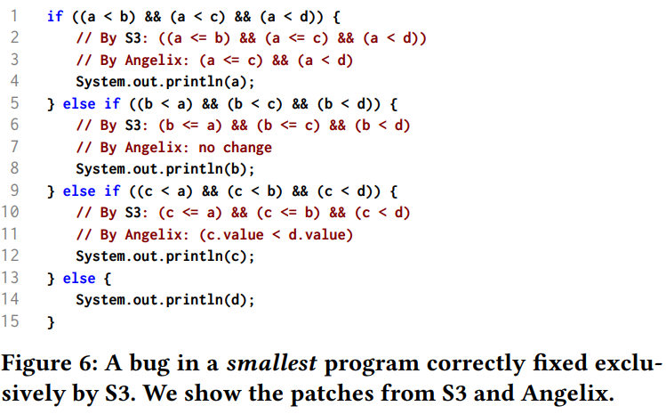
S3 : Some Examples

Slide 18
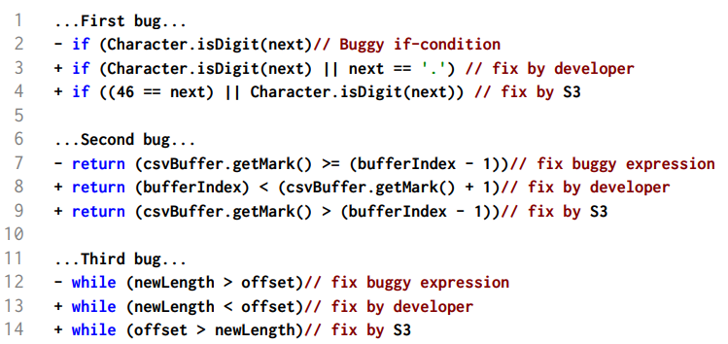
S3 : Some More Examples (Semantically Equivalent)

Slide 19
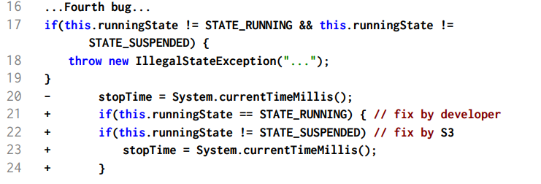
S3 : Some More Examples (Semantically Equivalent)

